Slide 1
Block Elements

Slide 2
Introduction
Every HTML element has a default display value, depending on what type of element it is.
There are two display values: block and inline.
- Block Elements - <h>, <p>, <div>, <hr> <header>, <footer>

Slide 3
Block-level Elements
Always starts on a new line, and the browsers automatically add some space (a margin) before and after the element.
Always takes up the full width available (stretches out to the left and right as far as it can).
Two commonly used block elements are: <p> and <div>.
The <p> element defines a paragraph in an HTML document.
The <div> element defines a division or a section in an HTML document.

Slide 4
<header>: Represents the header of the webpage and can contain headings, navigation menus, logos, etc.
<div>: A generic container used to group elements together and apply styles.
<h1>, <h2>: Heading elements for creating different levels of headings.
<p>: Paragraph elements for text content.
<hr>: Represents a thematic break or horizontal rule.
<footer>: Represents the footer of the webpage and can contain copyright information, links, etc.

Slide 5
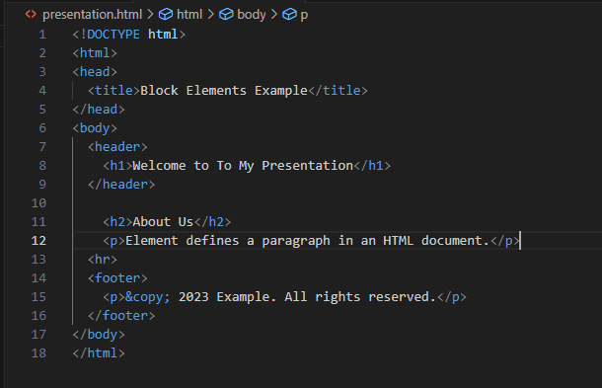
Practical Presentation

